Slide 1
1520 Signal Ltd.
Company Profile

Slide 2
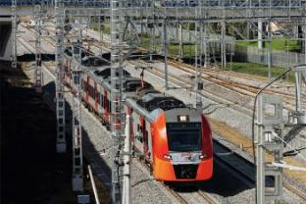
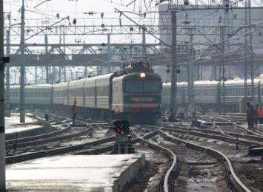
1520 SIGNAL Ltd. OVERVIEW
1520 SIGNAL Ltd.
RZD dependent entity with a share capital spread between the following companies: JSC RZD with 36% of shares, 1520 Group of companies with 64% of shares
LICENCES
Implementation and maintenance of EBILock 950, INTERFLO 150
ESTABLISHED IN 1996
Today the company has successfully implemented:
state-of-the-art interlocking signaling systems at more than 600 stations (14 000 + points)
2 400 km of automatic line blocks and 2 700 km of lines equipped with RBTC solutions
major projects in 12 countries outside Russia - almost in each 1520 gauge country
FULL-RANGE OF SIGNALLING SOLUTIONS
Currently 1520 Signal Ltd. is the leader in the Russian market of automatic train control systems by volume of implementation of the full-range of signaling solutions.
SERVICE CENTRES
are available in 10 cities of the Russian Federation: Moscow, Rostov-on-Don, Saratov, Yekaterinburg, Chelyabinsk, Novosibirsk, Krasnoyarsk, Irkutsk, Chita, Khabarovsk;
In 3 CIS countries and 1 service center in Mongolia

Slide 3
JOINT COMPANY
Bombardier Transportation (Signal) Ltd. has been renamed in 1520 Signal Ltd.
Bombardier Transportation
Sweden AB
60 % of share capital
ZHDA JSC
4% of share capital
RZD JSC
36% of share capital
Bombardier Transportation
(Signal) Ltd.
acquisition of shares
has been renamed
1520 Group of Companies
64% of share capital
«1520 Signal Ltd.

Slide 4
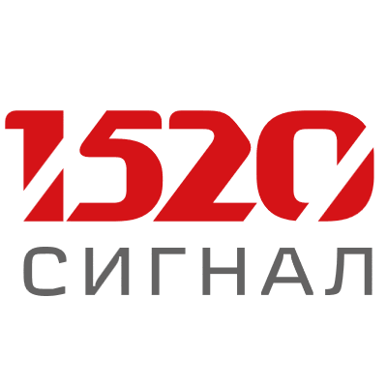






COMPANY HISTORY
1996
1999
2000
2001
2004
2006
2007
2009
2010
2011
2012
2013
The 100-th station equipped with EBILock 950 CBI
The 200-th station equipped with CBI EBILock 950.
Best Quality Prize from RZD.
Engineering Center in the Ukraine.
Izmir
(Izmir LRTS)
Launch of the first CBI EBILock 950 system in Russia (Kalashnikovo station)
Aksaray Airport
(Istanbul LRTS)
Entry to CIS market. the First contract in Uzbekistan
Entry to the new market - Kazakhstan. The First RBTC technology project started
IRIS certification
Entry to Turkmenistan and Mongolia
Entry to Latvia. Further rollout in Russia
The First project in Europe (Slovakia)
The first automatic line block system in Russia integrated in CBI
The First project in Lithuania
The First hybrid interlocking system (Abakan)
JV establishment (RCS 60%,
JSC “RZD” 36% and JSC“Zheldoravtomatizatciya” 4%)
The First projects in Belarus and Yakutia
The First Azerbaijan project
2014
2015
2016
2017
2018
2019
2020
2021
2022
2023
Winner of the tender together with ELTEZA 1111 km
Contract with Turkmenistan for the Bereket-Etrek line
ETCS trail operation Level 3 in Great Britain
2 RBTC lines are launched in Kazakhstan.The new contract in Kazakhstan (over 1200 km).
The First implementation of the cybersecurity system. Entry to Serbia (Resnik-Valevo)
The First mass-transit project in Moscow metro
BHP project in Australia
(iron stone)
The project in Azerbajan
Mongolian project fulfillment
- 1111km of
RBTC system.
15 January - the company changed its name into 1520 Signal Ltd.
Rudnevo electric depo was commissioned in the Moscow Metro.
Winner of the Moscow Mayor competition «The Best Project Realized»
Modernization of Zemun technical and passenger station and depo in Belgrad, Serbia
Tram automation for the first time was put in trial operation in Moscow
Rail TMS system was put into trial operation in Kazakhstan on the Zhetygen-Altynkol line
The Russian CBI-EL-20 on completely domestic components was first introduced at st. Panteleevo of Northern Railway.
Digitization of the largest industrial transport facilities: «OVE» JSC polygon, Inaglinsky MMP and Kurskagroterminal Ltd.
Equipping Big Circle Line and its depots with our own digital systems
Active equipping the MDC stations with the domestic computer-based system CBI-EL
The modernization of the Eastern polygon objects (BAM and TRANSSIB) is in process
The project in Uzbekistan
Over 400 stations are in commercial operation under EBILock 950
Launch of he Moscow Central Circle

Slide 5
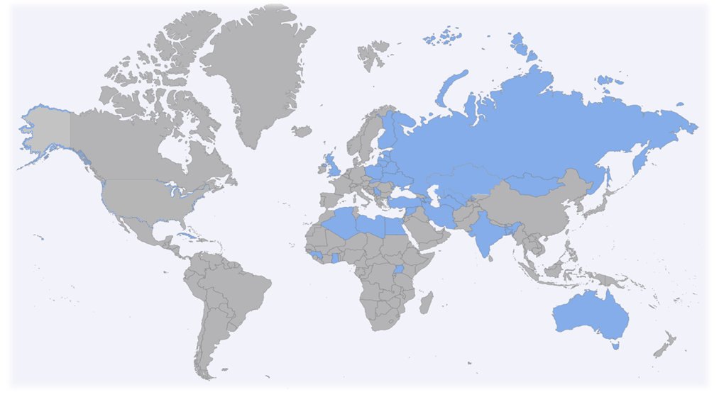





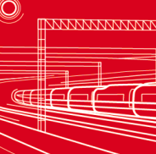

GLOBAL MARKETS OF THE 1520 SIGNALING DIVISION
> 100 projects
in 15 countries
RUSSIA
KAZAKHSTAN
LATVIA
BELARUS
LITHUANIA
> 900 MUSD of export contracts have been executed
GREAT BRITAIN
UKRAINE
SLOVAKIA
MONGOLIA
SERBIA
UZBEKISTAN
TURKMENISTAN
AZERBAIJHAN
Design
AUSTRALIA
Traffic Control
TURKEY

Slide 6










SIGNALING SYSTEMS IMPLEMENTATION GEOGRAPHY
Country | Stations | Points | RBTS (km)
Azerbaijan | 21 | 580 | 300
Belarus | 1 | 71 | 0
Kazakhstan | 71 | 952 | 1600
Latvia | 34 | 842 | 226,6
Lithuania | 14 | 243 | 200
Mongolia | 4 | 18 | 1100
Turkmenistan | 24 | 215 | 628,5
Turkey | 38 | 105 | 78
Slovakia | 3 | 87 | 0
Serbia | 10 | 47 | 78
Great Britain | 2 | 10 | 6
Uzbekistan | 30 | 541 | 140
Ukraine | 7 | 79 | 105,8
Australia Russia | 36 380+ | 350 11 000+ | 500 1100+

Slide 7
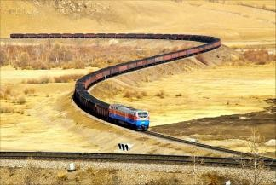





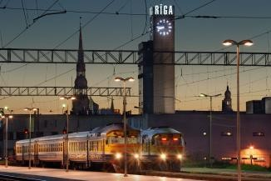



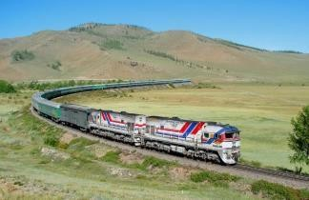




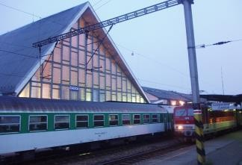



IMPORTANT INTERNATIONAL PROJECTS
MODERN TECHNOLOGIES FOR TRAIN CONTROL:
Kazakhstan: signaling and radio traffic control systems for the railway corridors Uzen – Bolashak, Arkalyk – Shubarkol, Zhezkazgan – Beineu (> 1200 km). Intelligent train management system (Rail TMS) on the Zhetygen-Altynkol line (293 km) - was commissioned in trial operation in December 2021.
Uzbekistan: signaling and communication railway systems of the Marakand – Karshi – Kumkurgan-Ketab – Termez line (> 450 km). Construction project design of the Sergeli line of the Tashkent metro.
Turkmenistan: signaling systems of the Chilmammet – Buzkhun and Bereket – Etrek lines as well as railway infrastructure of the port of Turkmenbashi
Mongolia: equipping the Trans-Mongolian railway (UBZhD) with signaling and train control systems via the radio channel (> 1100 km)
Azerbaijan: signaling and communication systems of the Boyuk – Kesik – Ujar section
Latvia: railway signaling systems of the Skriveri – Krustpils section, st. Bolderaja
Lithuania: signaling systems of the Kaishadoris – Radviliskis line and of the Kalvariya and Kena stations
Ukraine: signaling and communication systems of the Krasnograd – Lozovaya line
Belarus: CBI equipment at the Barbarov station
Slovakia: signaling equipment of the Chadca – Skalite section
Serbia: modernization of signaling and communication systems of the Reznik – Valjevo section
Turkey: design of signaling systems for the city transport system of Izmir (cooperation with Bombardier)
UK: Engineering for the project of ETCS L3 technology Implementation (cooperation with Bombardier)
Australia: Engineering for BHP project - implementation of ETCS L3 technology (cooperation with Bombardier)

Slide 8
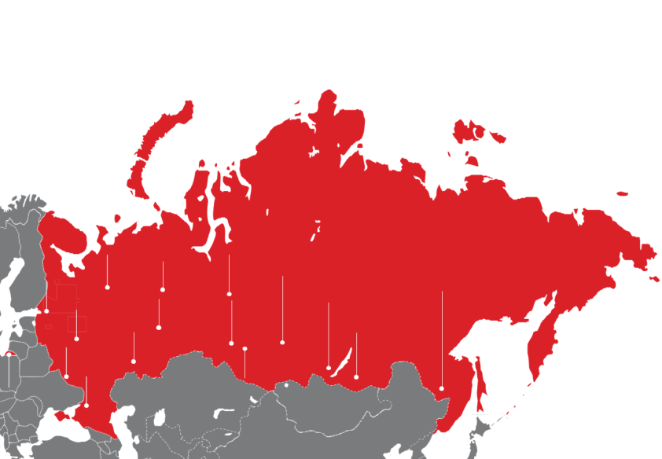
CBI SYSTEMS IMPLEMENTATION IN RUSSIA
380+ stations
11 000 + points
1 100 km of line-block
Nothern Railway
6 stations
Gorky Railway
19 stations
Sverdlovsk Railway
15 stations
October Railway
2 stations
Moscow Railway
36 stations
Krasnoyarsk Railway
13 stations
Kuybyshev Railway
5 stations
South Urals Railway
13 stations
Far Eastern Railway
26 stations
East Siberian Railway
26 stations
Privolzhsk Railway
7 stations
Zabaikal Railway
10 stations
Kaliningrad Railway
5 stations
South Eastern Railway
12 stations
West Siberian Railway
8 stations
North Caucasus Railway
6 stations

Slide 9
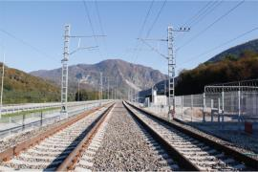

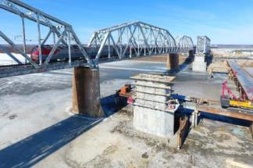
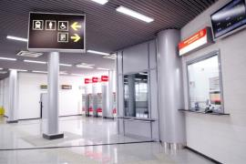
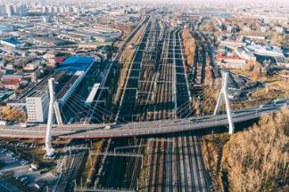
PROJECTS OF CRUCIAL IMPORTANCE IN RUSSIA:
FROM DESIGN TO CONSTRUCTION, OPERATION AND MAINTENANCE
Modernization of the Russian Railways Network (the planned program over 20 years, > 200 stations and open lines)
Modernization of the Eastern Polygon of the Russian Federation (BAM and TRANSSIB) – the main lines of the country (> 10,000 km)
Komsomolsk-on-Amur – Sovetskaya Gavan – the line reconstruction
Ussuriysk – Nakhodka – railway infrastructure development
Ukraine Bypass – construction and equipping of a new line Zhuravka – Millerovo
Mezhdurechensk – Taishet – overall integrated development of the railway line
Olympic Games 2014 in Sochi – construction and equipping of the transport infrastructure facilities
Moscow Central Circle (MCC) – reconstruction and modernization for optimization of the passenger traffic
Moscow Central Diameters (MCD) – reconstruction and modernization for optimization of the passenger traffic
Industrial rail traffic objects - OVE polygon, Inaglinsky MPP and Kurskagroterminal Ltd.
Moscow Metro Depots (Solntsevo, Rudnevo, Sokol), Circle Line, Big Circle Line and its electric depots (Nizhegorodskoye, Zamoskvoretskoye and Aminyevskoye) Koltsevaya (Circle) and Filyovskaya Metro Lines – signaling systems

Slide 10
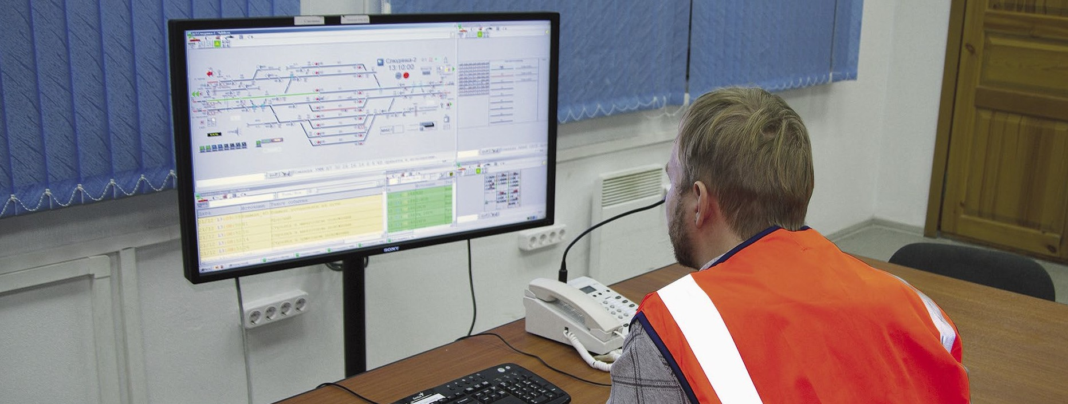
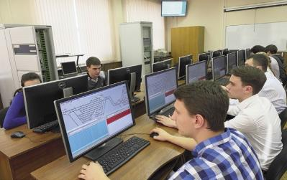
MAINTENENCE AND TRAINING ROOMS
MULTILEVEL SYSTEM OF TECHNICAL SUPPORT
a multi-level maintenance system takes into consideration the customers’ interests, the maintenance capabilities of the company and the required level of operational capability of the computer-based equipment.
a network of the regional service-centers
Training rooms, courses and programs
Training of the railroad staff
Cooperation with field-specific institutions
Training institutions
MIIT, the Andreev and Irkut railway colleges, the Moscow Railway, Republic Sakha Yakutia
Classes in the training room with the EBILock 950 computer-based interlocking in the MIIT

Slide 11
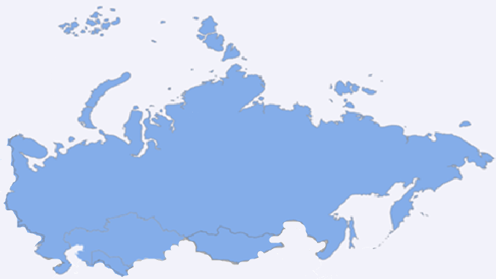
Service Centers Geography of the 1520 Signaling Division
SERVICE CENTERS GEOGRAPHY of 1520 SIGNAL Ltd.
14 service centers on the 1520 gauge
Krasnoyarsk
Russia – 10
CIS – 3
Mongolia – 1
Novosibirsk
Irkutsk
Chita
Ekaterinburg
Moscow
Saratov
Rostov-on-Don
Nur-Sultan
(KAZAKHSTAN)
Ulaanbaatar
(MONGOLIA)
Khabarovsk
Tashkent
(UZBEKISTAN)
Baku
(AZERBAIJAN)

Slide 12
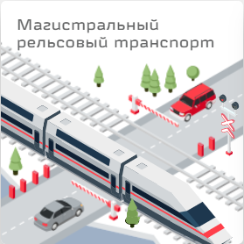
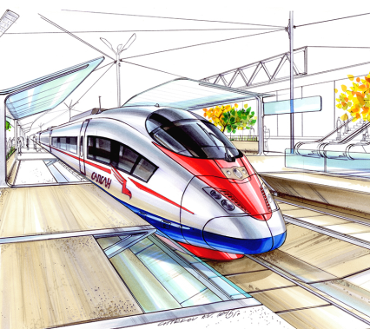
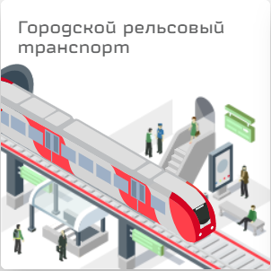
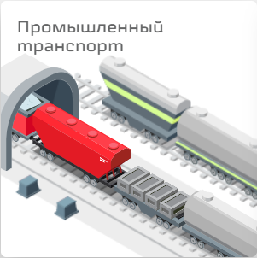
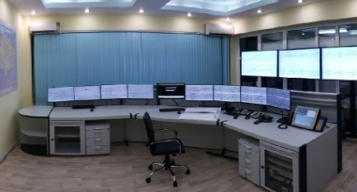
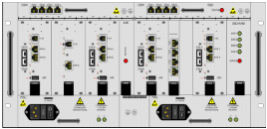





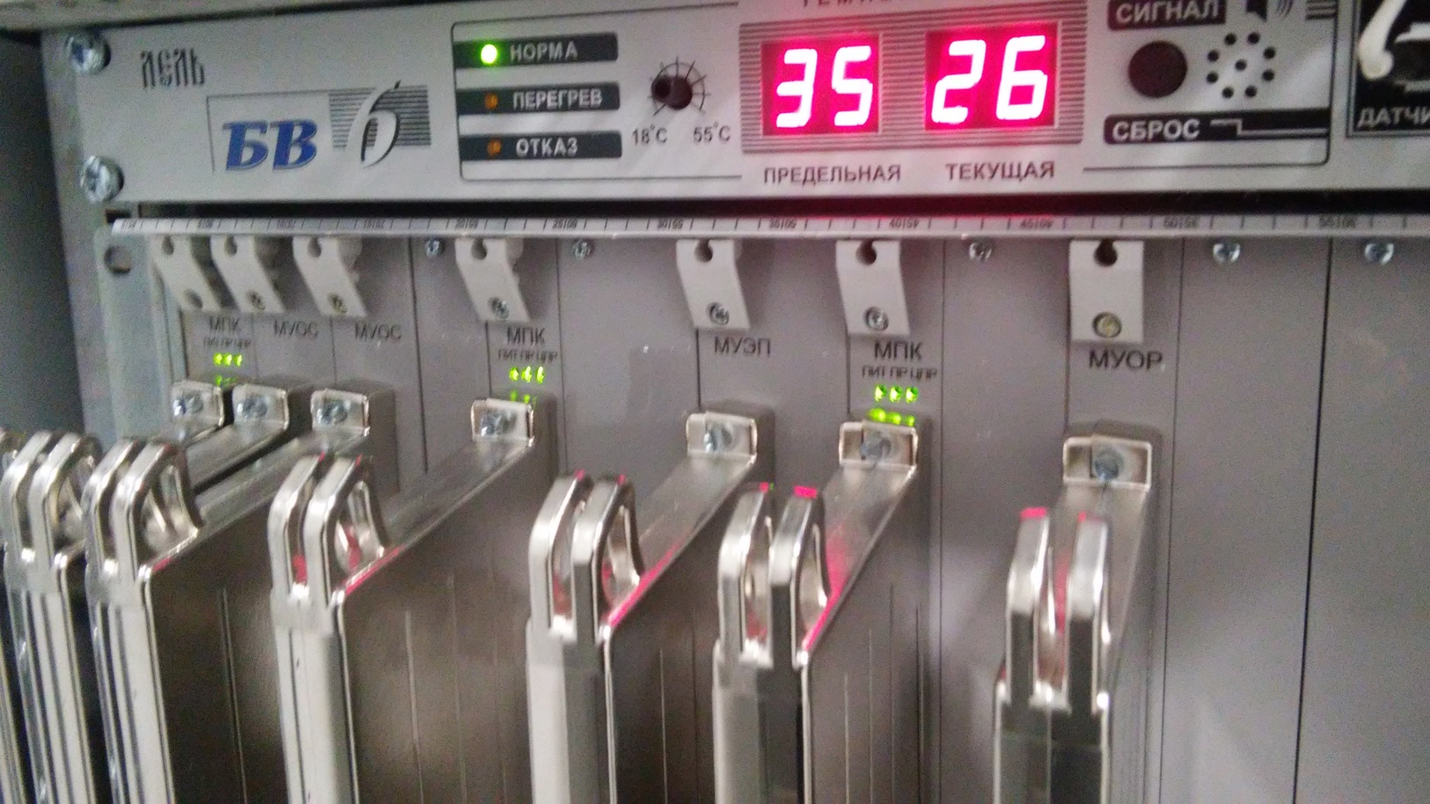



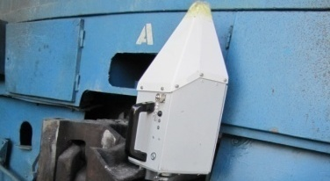


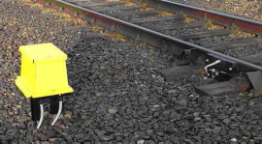
PRODUCTS AND SOLUTIONS OF 1520 SIGNAL Ltd.
Mainlines
Very High Speed Lines
Mass -Transit
Industrial Transport
Technical solutions for mainlines, high speed and very high speed lines of the mass transit and industrial transport are realized via the following components, manufactured with respect to the Customer demands:
Centralized Traffic Control (CTC)
Radio Block Center (RBC)
Central Processing Unit (CPU)
Level Crossings
Point Machines
Track Circuits
Onboard Systems
Object Controller System
Object Controller RUVIO
Lightening protection
Signals
End of the Train Device (TIMS)
Balises
Cybersecurity
Axle Counters

Slide 13


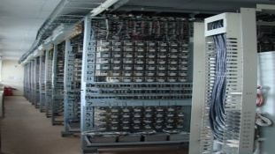

MAINLINES AND VHS LINES SIGNALLING SOLUTIONS OVERVIEW
HIS-E
CBI-E
RBTC system
Centralized Traffic Control (CTC)
Central processing Units (CPU)
Centralized Traffic Control (CTC)
Central Processing Units (CPU)
Centralized Traffic Control (CTC)
Central Processing Units (CPU)
RUVIO
Object Controllers
Existing Hybrid Interlocking System (HIS)
Object Controller System
Axle Counters or Track Circuits
Object Controller System
Radio Block Center
(RBC)
Increased safety on the railway due to optimizing the flow of trains with usage of centralized traffic control and central processing unit;
Overlay of the existing hybrid interlocking system in case of high-flexibility;
Archiving all commands/alarms/actions of workforce for quick data analysis;
Extended self-diagnostic system, which can predict failures of all subsystems;
Decreasing number of relay equipment which gives an advantage in saving space in control and server rooms.
Archiving all commands/alarms/actions of workforce for quick data analysis;
Integration with lines between stations for an efficient dispatching control and operation on the railway line;
Usage of highly innovative signaling technologies on the railway;
Complex cybersecurity system for incidents detecting, data archiving and operational staff notifying;
Extended number of technological functions depending on the requirements for the system;
Extended self-diagnostic system, which can predict failures of all subsystems.
Balises
End of Train Detection
Axle Counters or Track Circuits
Onboard Safety Systems
Possibility to arrange unequipped trains operation without considerable effect on the line capacity;
Possibility to use the RBTC system as a main or back-up system for lines with any signaling infrastructure.
*.

Slide 14
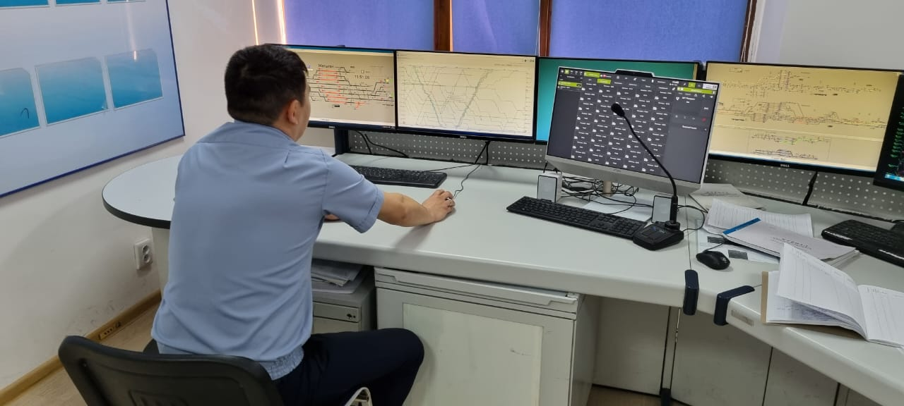
MAINLINES AND VHS LINES SIGNALLING SOLUTIONS OVERVIEW
Intelligent Train Management System (Rail TMS)
  Rail TMS was put into trial operation at the end of 2021 for the first time.The system will control traffic on the Zhetygen-Altynkol line with the total length of 293 km.
  ensures the continuity and safety of the transportation process
  maximizes the efficiency of transport corridors
  applies algorithms based on neural networks.
  uses artificial intelligence and machine learning technologies to build and control train schedules in the shortest possible time
  highly fault-tolerant
  provides a flexible approach to train management at the scale of individual lines as well as polygons
Счетчики Осей и Рельсовые Цепи
*.

Slide 15
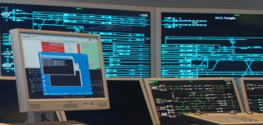





MASS-TRANSIT SIGNALLING SOLUTIONS OVERVIEW
Metro and Light Rail Transport Systems
Central Traffic Control
  The architecture of computer-based interlocking:
  has fully micro-processing system starting from interlocking processing unit till object controller system;
  has extended self-diagnostic system, which can predict failures of all subsystems;
  has transmission from regular scheduled maintenance to maintenance “when required”;
  has full redundancy, if failure of the main system occurs it guarantees transmission to the reserve;
  has integrated overvoltage protection system;
  under the Client’s requirement architecture can be built with:
hot standby redundancy;
with specific redundant subsystems;
without redundancy.
Dispatching center
Central
Processing Unit (CPU)
Object Controller System
Track Circuits and
Automatic Speed Control
Generators
Points
Signals
Wayside equipment
Point machines
Signals
15
*.

Slide 16
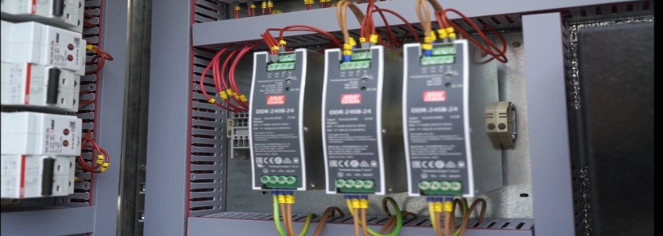
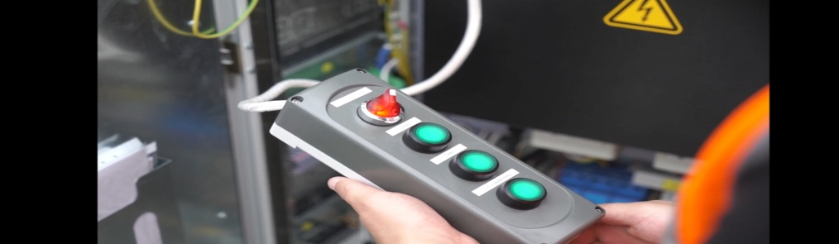
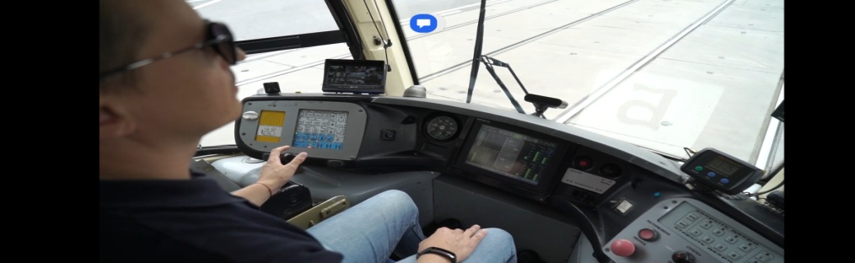
MASS-TRANSIT SIGNALING SOLUTIONS OVERVIEW
Tram signaling solution: Automatic System for Integrated Tram Traffic Management
  .
  was developed as part of solution for modernizing the infrastructure of tram transport.
  significantly increases the speed of trams passing points, raises the level of automation and work culture of operational and maintenance personnel.
  according to the results of trial operation the Automatic System for Integrated Tram Traffic Management has shown high reliability and efficiency and has been approved for use at the transport infrastructure in Moscow.
*.

Slide 17
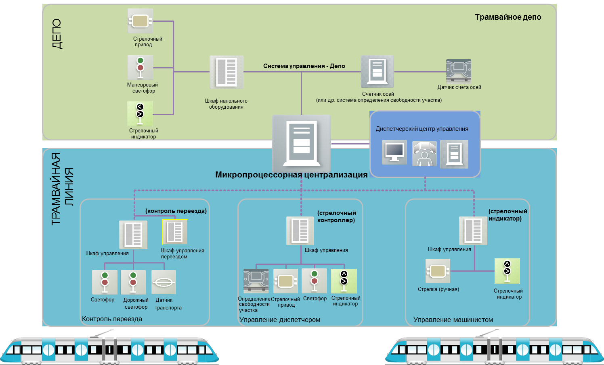
SOLUTION FOR TRAM SYSTEMS
DEPOT
Tram depot
Point Machine
Control system - Depot
Shunting
Signal
Axle counting Sensor
Wayside Equipment
Cabinet
Axle Counter
(or other system of track vacancy detection)
Signal Point Indicator
Traffic Control Center
TRAM LINE
Computer-based Interlocking
(LX Control)
(Point Control Switch)
(Point Indicator)
Control Cabinet
LX Control Cabinet
Control Cabinet
Control Cabinet
Track Vacancy Detection
Manual Point
Point Indicator
Signal
Traffic
Signal
Vehicle
Sensor
Point Machine
Signal
Point Indicator
LX Control
Dispatcher Control
Driver Control

Slide 18











SOLUTIONS FOR LIGHT RAIL TRANSPORT
Radio Block Center Level
LCSS
FEU
LAN of the Central Dispatch Center
Gateway
CBTC equipment
EBILock
Data transmission system (radio channel)
Signals
Points
Relay Interlocking
FOCL
Station
CBTC + Automatic Locomotive Signaling System
*LCSS– local control supervisory system of the central dispatcher center; ATP – Automatic Train Protection; FOCL – fiber-optic link; LAN – local network of the central dispatcher center; ATC – Automatic Train Control; CBTC – Communications-Based Train Control; EBILock – Bombardier Transportation’s trademark.

Slide 19
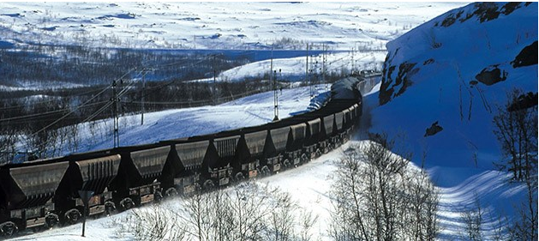












INDUSTRIAL SIGNALING SOLUTIONS OVERVIEW
Signaling Solution for underground transportation:
Overground Signaling Solutions are the same as for the Mainlines
Dispatcher
TCC, Combined TMS,
Interlocking and RBC
Movement commands are sent to the train via Wi-Fi or other possible telecommunication solutions;
Minimization of the wayside equipment installation;
Virtual fixed block;
Unattended, driverless trains;
Radio-based or cable data transmission with object controllers.
I/O (OCS)
Wi-Fi
L
U
IF150 Onboard
Point machine
Barriers
Loading
Stations
Unloading
Stations
Fixed Euro-balises

Slide 20

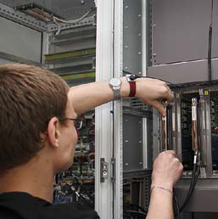
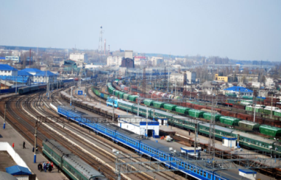
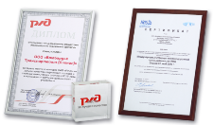



STRATEGIC PARTNER OF YOUR RAILWAYS
1520 Signal has pioneered in many areas and continues to enter and develop railway signaling markets:
Full range of Products including highly efficient and technological Computer-based interlocking, Computer-based line block system, Radio-based train control systems;
Over 300 stations implemented across Russia and over 500 in total at 1520 area – huge experience of implementation, daily support, integration with existing rail infrastructure systems and increasing CBI functionality;
Organization of 24/7 technical support and service centers network, training rooms and programs, cooperation with railroad universities and colleges;
Solutions on gradual and partial modernization of existing interlocking;
Complex protection from atmospheric and mutation overvoltages;
Railway certifications, incl. IRIS;
Cybersecurity and other innovative components for the signaling system.

Slide 21








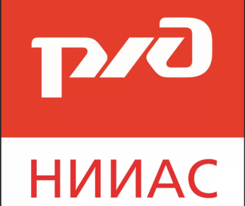


TECHNOLOGY PARTNERS OF 1520 SIGNAL Ltd.

Slide 22

















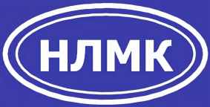





CUSTOMERS OF 1520 SIGNAL Ltd.

Slide 23
Letchika Babushkina, estate 1, bld.2,
Moscow, Russia, 129344
Tel.: +7 (495) 901-15-20
E-mail: info@1520signal.ru
www.1520signal.ru
THANK YOU FOR YOUR ATTENTION!

